Slide 1
Public Health Dashboard and Reporting Covid-19 Data Analysis
Presented By: Offodum Sandra
November 15, 2023

Slide 2
Outline
Goal of Analysis
Overview
Regions Covered
Demographics
Age adjusted covid-19 death rate
Crude covid-19 death rate
Covid-19 death Count
Conclusion
Reference

Slide 3
Goal of analysis
Summarizing key health indicators and trends

Slide 4
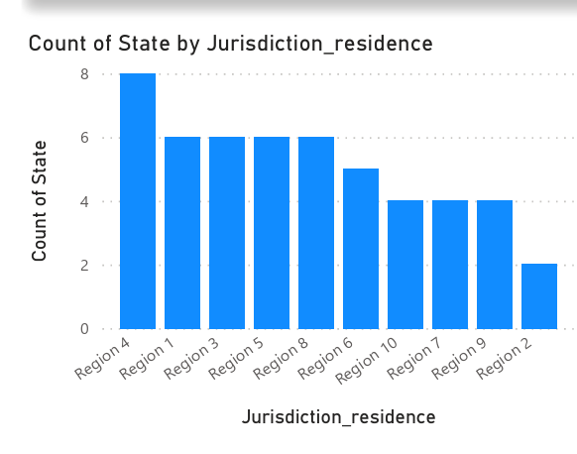
Overview
The data used contained COVID-19/covid death counts and rates by jurisdiction of residence (U.S., U.S department of Health & Human Services(HHS) Region) as at 26th October 2023. HHS Region covered 10 areas/states while the United States (U.S) include the 50 states, plus the District of Columbia.
The highest number of states in the HHS Region was Region 4 while the least number of states was Region 2

Slide 5
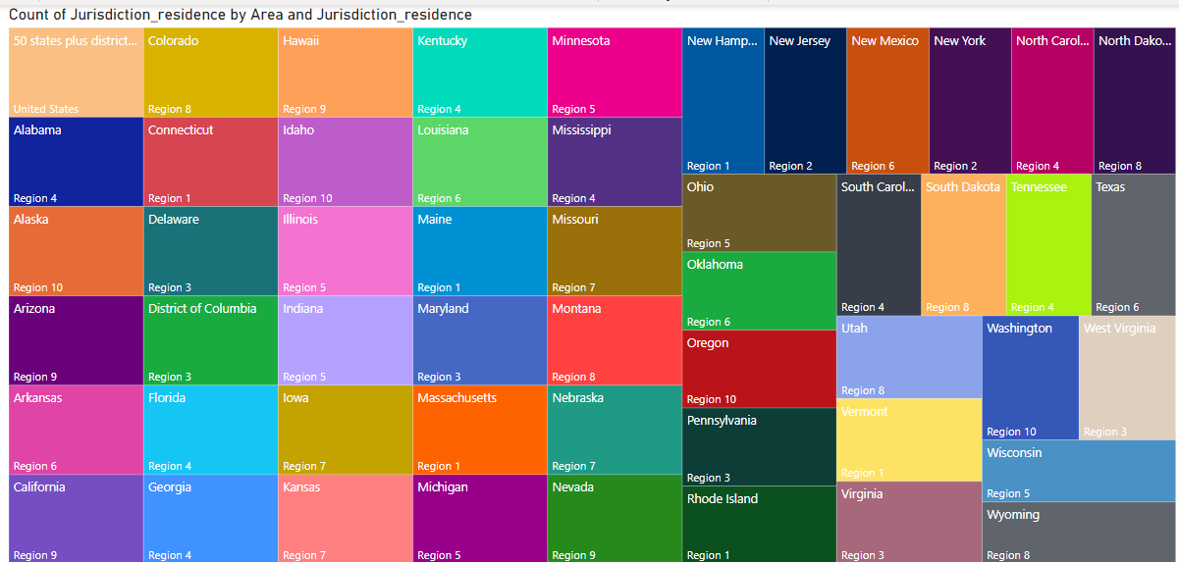
Regions covered

Slide 6
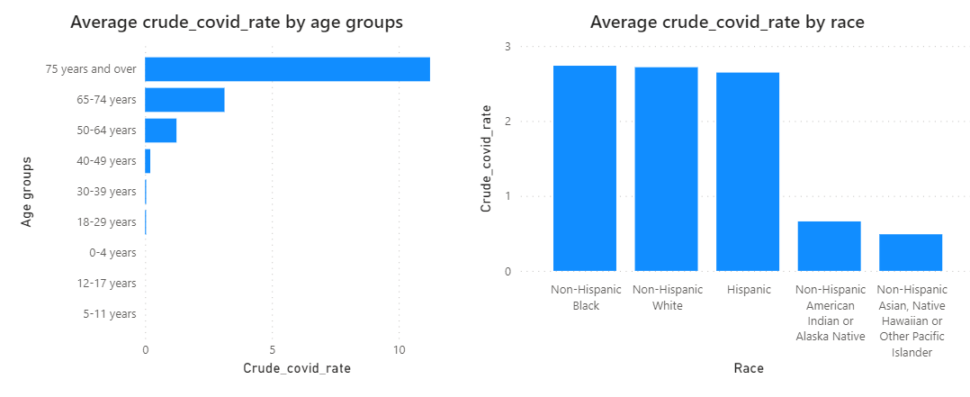
Demographics
On the average, older people of 50years and above when compared with the population in the regions/states died more of covid, while the least age groups who rarely died of covid were below 17 years.
The Non-Hispanic race died more of covid when compared to the Hispanic race

Slide 7
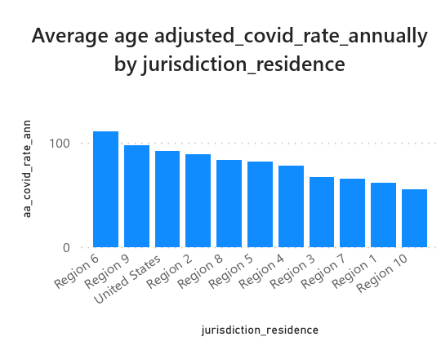
Age adjusted covid death rate
On the average, the rates at which people died of covid annually were higher in Region 6 and 9 when age difference was accounted for while the rate was lower for Region 10.
This rate gives more accurate comparison of death rates between jurisdiction residence.

Slide 8
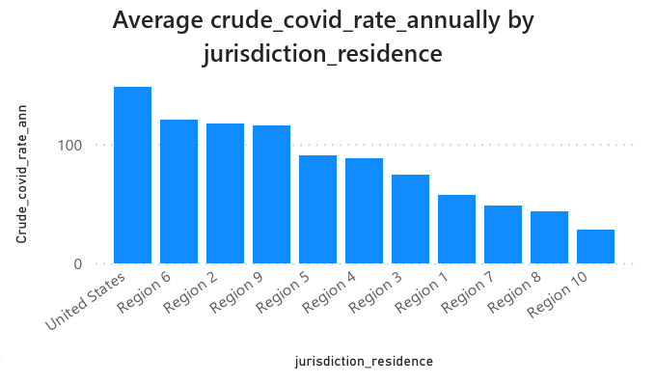
Crude covid death rate
On the average, the rate at which people died of covid were higher in Region 6 and Region 2 while the rate was the least in Region 10.
This rate doesn’t account for other factors like age, thus made it not as accurate as the age-adjusted death rate. This gives a general idea of death rate in the jurisdiction residence.

Slide 9
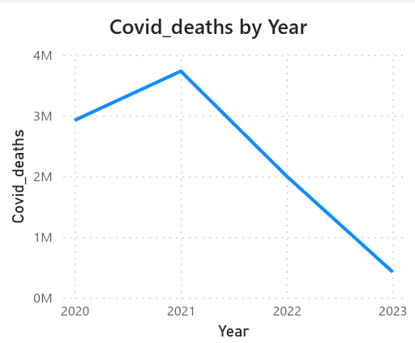
Covid death Count
More deaths from covid were observed in 2021 in all jurisdiction residence while a sharp decline in covid deaths was observed from 2021 to the date of update of this data, 26th October 2023.

Slide 10
Conclusion
Older people died more of Covid. Covid death rate were on the high in Region 6 which covered Arkansas, Louisiana, New Mexico, Oklahoma and Texas. 2021 recorded more deaths from Covid.

Slide 11
Reference
https://dev.socrata.com/foundry/data.cdc.gov/dmnu-8erf

